Slide 1
State Pattern cont…

Slide 2
Recall: Pros of State Pattern
Localizes state-specific behavior:
  Partitions behavior for different states into separate objects.
Makes state transitions explicit
  Moving from one state to another becomes Obvious --- appropriate state object must be swapped in…

Slide 3
When are Concrete State Objects Created?
Two options:
  Created as and when (each time) they are needed.
  Created once, used whenever needed in the Context class

Slide 4
Food for thought…
Where to define the state transitions ?
  For simple cases, transition can be defined in the context.
  More maintainable if transitions are specified in the State subclass.
Whether to create State objects as and when required or to create-them-once-and-use-many-times ?
  First one is desirable if state changes are infrequent.
  Later one is desirable if the state changes are frequent.

Slide 5
Washing Machine Example
Suppose a washing machine has two states (ON, Off). Following GoF vocabulary:
  Context => WashingMachine
  State => WashingMachineState
  Concrete states => StateOn, StateOff

Slide 6
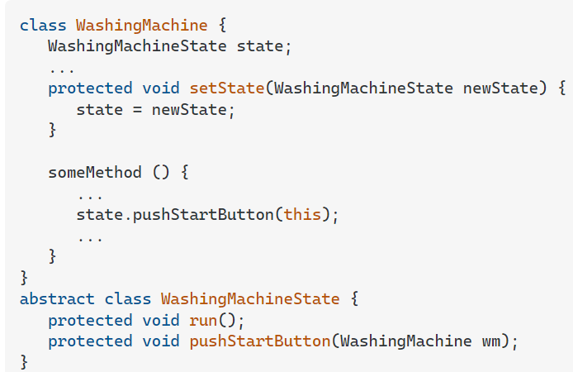
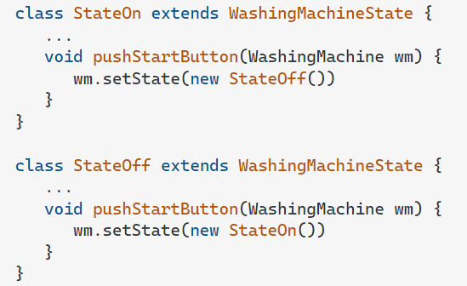

Slide 7
State Pattern: Final Analysis
Advantages
  Switch-case statement is not efficient. On the average, half of the options need to be examined.
  Also, Code becomes modular, otherwise:
    All States get handled in one place (switch-case):
    Changes to any state logic would need recompilation and retesting.

Slide 8
Known Uses and Related Patterns
Several interactive drawing programs use the State pattern.
The Flyweight pattern explains:
  When and how State objects can be shared.
State Objects are often Singletons.

Slide 9
Bonus Problems
How can nested states be handled?
How can AND states handled?
How can history state be handled?
Mail me your solution illustrated with suitable examples

Slide 10
Composite Pattern

Slide 11
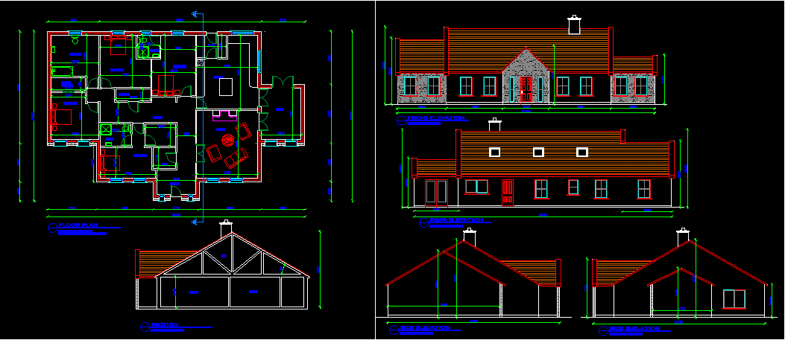
Composite: Introduction
A composite is a group of objects in which some objects contain others:
  An object may represent a group.
  Or may represent an individual item.
Example 1: A drawing---
t1 : Group
a : Leaf
b : Leaf
t2 : Group
c : Leaf
t3 : Group
e : Leaf
d : Leaf
e : Leaf

Slide 12
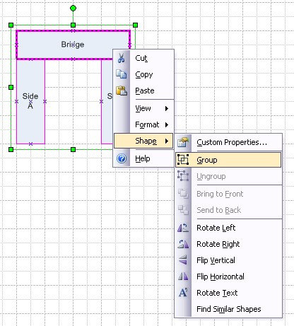
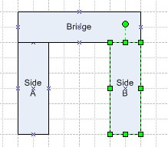
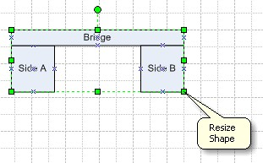
Example: Consider a Graphics Editor…
You can build complex diagrams using simple components
  Group components to form larger components...
  ...which in turn can be grouped to form still larger components…

Slide 13
Composite Pattern: Intent
Compose nested group of objects into a tree structure to represent part-whole hierarchies.
  Clients should be able to treat individual objects and compositions the same way.
t1 : Group
a : Leaf
b : Leaf
t2 : Group
c : Leaf
t3 : Group
e : Leaf
d : Leaf
e : Leaf

Slide 14
Why Composite Pattern? (Motivation)
What problems might occur if composite pattern is not used?
  Client code must treat primitive and container classes differently…
  Makes the application more complex.
  Additions of new components becomes troublesome…

Slide 15

Composite Solution: Attempt 1
Problem: handling nested groups of objects
Composite
*
Leaf
children
…
if X is Composite then
X.forall()
else X.operation();
...
forall()
operation()
Lets see a designer attempting to design a class structure from scratch…
For all children c:
c.operation()
Analysis of Solution: Naïve solution…
What are the problems?
Only single nesting level (depth =1)
Composite and leafs always treated differently in code
-Difficult to extend with new kinds of leafs or composites.

Slide 16
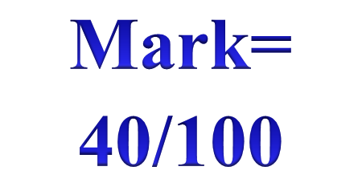
Composition: Attempt 2
Client:
children
*
item.operation()
Item
íf there are children then
for all children c: c.operation()
else doSomething();
operation()
Surely there are improvements…
Unified treatment in client and unrestricted depth of parts…
What are the problems?
-Does not handle different item types
-Difficult to extend with new kinds of leafs or composites.

Slide 17
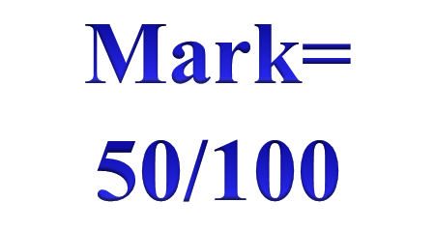
Attempt 3: Handling different Items
*
children
Item
operation()
New types of elements:
íf I have children then
for all children c: c.operation()
else doSomething1()
íf I have children then
for all children c: c.operation()
else doSomething2()
Item1
Item2
operation()
operation()

Slide 18

Finally: Composite Pattern
Separating the composite class:
children
*
Item
<<abstract>>
operation()
Item2
Item1
Composite
for all children c: c.operation()
operation()
operation()
operation()

Slide 19
Composite Design Pattern
Problem: How to organize hierarchical object structures so that the clients are not aware of the hierarchy?
Solution:
Item
*
operation()
children
Leaf
Composite
For all children c:
c.operation()
operation()
operation()

Slide 20
Composite Pattern: Issues for Discussion
What is the class diagram?
Who is the client?
What operations are defined for:
  The component, the composite, and the leaf?
  How are they carried out?
How are associations implemented in the code?

Slide 21
Composite Pattern: Class Diagram
Client
Component
<Abstract>>
*
operation()
Leaf
Composite
operation()
operation()
other()
Each node of the Component structure can respond to some common operation(s).
The client can call operations of the Component and the structure responds “appropriately”.

Slide 22
Client
The client is any class that operates on the composite:
  It manipulates objects in the composition through the Component interface
Ex. VLSI CAD software
Client
Component
move()
add(Component)
remove(Component)

Slide 23
Component
Client
Component is an abstract class:
  Declares the interface for accessing and managing its child components
  Defines an interface for default behavior.
  Optionally provides access to the parent component
Component
<<abstract>>
*
operation()
Leaf
Composite
operation()
operation()
other()

Slide 24
Composite: Object Diagram
top : Composite
a : Leaf
b : Leaf
top : Composite
c : Leaf
top : Composite
e : Leaf
d : Leaf
e : Leaf

Slide 25
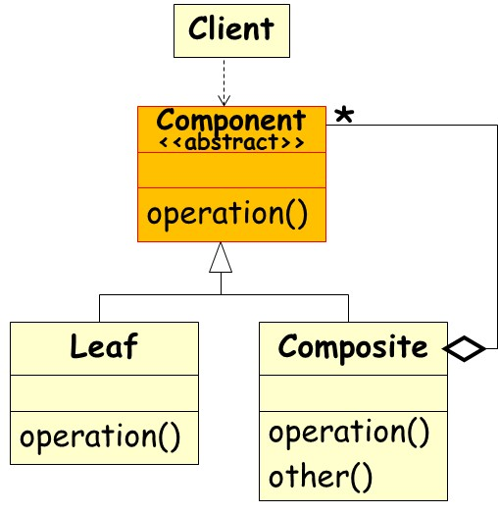
Other Participants
Leaf
  A leaf has no children.
  Defines behavior for primitive objects in the composition.
Composite
  Defines behavior for components having children.
  Stores Ids of child components.
  Implements child management methods.

Slide 26
Interaction with Clients
Clients use the Component class interface to interact with objects.
If the recipient is a Leaf:
  Then request is handled directly
If the recipient is a Composite:
  Forwards the request to child components

Slide 27
Consequences
Makes it possible to define recursive compositions of primitive and composite objects.
Makes the client simple.
  They don’t need to know whether they are dealing with leaves or composites.
Makes it easier to add new kinds of components.

Slide 28
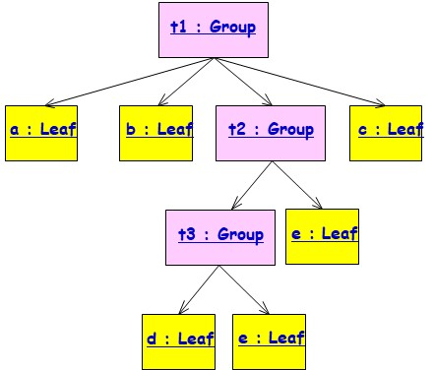
Applicability
Use the Composite pattern when:
  You need to represent part-whole hierarchies of objects
  You want clients to ignore the differences between parts and wholes
  Especially, if the parts are created dynamically – at run time:
    Example: to build a complex system from primitive components and previously defined subsystems.
    This is especially important when the construction process will reuse subsystems defined earlier.

Slide 29




Composite Pattern models dynamic aggregates
Fixed Structure:
Car
*
*
Doors
Wheels
Organization Chart (variable aggregate):
University
*
*
Department
Dynamic (recursive) aggregate:
Program
*
*
Block
Compound
Simple
Statement
Statement
Notes:
What you are seeing on this slide are what I would like to call patterns for analysis.
A pattern is a recurring theme, something once you get used to see something this way, allows you to very fast understand a situation.
It is well known, that if you show a set of chess positions of middle games tochess masters and non chess players, that chess masters are able to reconstruct these games without any effort.
However, if you give them random chess configurations, chess masters are about as bad as non-chess players in reconstructing the boards.
This tells you about the value of patterns. I would like you to learn about these aggregation patterns. In fact, I challenge you to see for your team and subsystem, if any of the analysis problems you face, can be cast in terms of one of the 3 patterns above.

Slide 30
Composite: Object Diagram
top : Composite
a : Leaf
b : Leaf
top : Composite
c : Leaf
top : Composite
e : Leaf
d : Leaf
e : Leaf

Slide 31
class MainApp {
static void Main(){
// Create a tree structure
Composite root = new Composite("root");
root.Add(new Leaf("Leaf A"));
root.Add(new Leaf("Leaf B"));
Composite comp = new Composite("Composite X");
comp.Add(new Leaf("Leaf XA"));
comp.Add(new Leaf("Leaf XB"));
root.Add(comp);
root.Add(new Leaf("Leaf C"));
// Add and remove a leaf
Leaf leaf = new Leaf("Leaf D");
root.Add(leaf);
root.Remove(leaf);
// Recursively display tree
root.Display(); }
}
-root ---Leaf A ---Leaf B ---Composite X -----Leaf XA -----Leaf XB ---Leaf C

Slide 32
// "Component"
abstract class Component
{protected string name;
// Constructor
public Component(string name)
{this.name = name;}
public abstract void Add(Component c);
public abstract void Remove(Component c);
public abstract void Display();
}

Slide 33
// "Composite"
class Composite extends Component
{private ArrayList children = new ArrayList();
// Constructor
public Composite(string name) {super(name); }
public void Add(Component component)
{children.Add(component);}
public void Remove(Component component)
{children.Remove(component);}
public void Display(int depth) //override
{System.out.println(new String('-', depth) + name);
// Recursively display child nodes
for(Component component : children)
component.Display()
}
}

Slide 34
// "Leaf"
class Leaf extends Component
{// Constructor
public Leaf(string name) {super(name);}
public void Add(Component c) // override
{System.out.println("Cannot add to a leaf");}
public void Remove(Component c) //override
{System.out.println("Cannot remove from a leaf");}
public void Display(int depth) //override
{System.out.println(new String('-', depth) + name);}
}
}

Slide 35
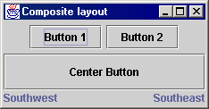
Composite example: Jpanel
Container north = new JPanel(new FlowLayout());
north.add(new JButton("Button 1"));
north.add(new JButton("Button 2"));
Container south = new JPanel(new BorderLayout());
south.add(new JLabel("Southwest"), BorderLayout.WEST);
south.add(new JLabel("Southeast"), BorderLayout.EAST);
// overall panel contains the smaller panels (composite)
JPanel overall = new JPanel(new BorderLayout());
overall.add(north, BorderLayout.NORTH);
overall.add(new JButton("Center Button"), BorderLayout.CENTER);
overall.add(south, BorderLayout.SOUTH);
frame.add(overall);
JPanel, a part of Java Swing package. It is a container that can store a group of components. The main task of JPanel is to organize components

Slide 36
Some Insights…
Why do you declare the methods to handle children in the abstract class?
  Only the composite class has any use for them?
  Is it not poor programming practice to have these methods inherited by primitive classes, which have no use for them?
There is a tradeoff here between safety and elegance…

Slide 37
Elegance
If the child management methods are moved from the abstract class to the composite one,
  The client can no longer call these methods on primitive objects, improving elegance.
However, this gives primitive and composite objects different interfaces:
  Which is what the design pattern is to avoid…

Slide 38
Composite Pattern: Example 1
MenuComponent
add()
remove()
print()…
*
Manager
MenuItem
Menu
add()
remove()
print()…
print()
How to print a menu?

Slide 39
Example 1
Menu
menuComponents: ArrayList
add()
remove()
print()…
Menu to MenuComponents association implemented with an ArrayList data type.
Let us examine what is the implementation of print() in Menu and in MenuItem…

Slide 40
Example 1
Class Menu implements MenuComponent{… … …
public void print() {
System.out.print("\n" + getName());
System.out.println(", " + getDescription());
System.out.println("----------------");
Iterator iterator= menuComponents.iterator();
while (iterator.hasNext()) {
MenuComponent menuComponents =
(MenuComponent)iterator.next();
menuComponents.print();
}
}

Slide 41
class MenuItem implements MenuComponent{ … …
public void print() {
System.out.print(" " + getName());
if (isVegetarian()) System.out.print("(v)");
System.out.println(", " + getPrice());
System.out.println("--" + getDescription());
}

Slide 42
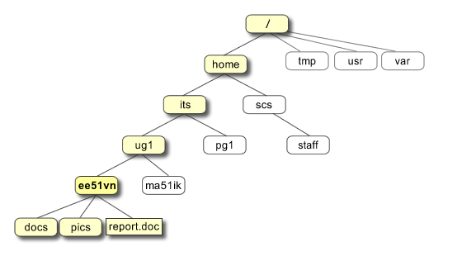
Exercise 1
Design a class structure to model a file hierarchy in Unix…

Slide 43
Exercise 1: Solution
Folder
<<Interface>>
*
children
delete()
print()
File
Directory
For all children c:
c.delete();
Delete directory
delete()
print()
delete()
print()
add(Source)

Slide 44
Component _{A}
Now Suppose file types are text, image, Video…
setName();
getName();
getAllFiles(List theList);
getContents(List theList);_{A}
*
Directory
TextFile
ImageFile
VideoFile
setName();
getName();
getAllFiles(List theList);
getContents(List theList);
setName();
getName();
getAllFiles(List theList);
getContents(List theList);
setName();
getName();
getAllFiles(List theList);
getContents(List theList);
setName();
getName();
getAllFiles(List theList);
getContents(List theList);
This is the Composite
These objects are the leaves

Slide 45
Composite
Leaf
Composite
Composite
Leaf
Composite
Leaf
Leaf
Composite
Leaf
Etc…

Slide 46
Exercise 3: Programming
A program block can contain simple statements or other program blocks…
Item
*
Statement
execute()
Leaf
Composite
SimpleStatement
Block
children
execute()
execute()

Slide 47
Exercise 4
Develop class design of components to be handled by a Graphics editor:
  Should let users group simple components into larger components.
    Which in turn can be grouped to form still larger components.
    Larger components should behave similarly w.r.t. select, copy, paste, move,delete, resize, ...

Slide 48
Solution
A key idea in the Composite pattern:
  An abstract class that represents both primitives and their containers.
  The abstract class Graphic declares operations like Copy, Move, Delete, resize, etc. that are specific to graphical objects.
  It also declares operations that all composite objects share, such as
    Operations for accessing and managing its children, like Add, UnGroup.

Slide 49
Composite Pattern: Solution
<<Component>>
Graphic
*
contains
*
contains
Resize()
Operation()
0..1
0..1
<<Leaf>>
<<Composite>>
Rectangle
Circle
Picture
Operation()
AddComponent()
RemoveComponent()
GetChild()
Resize()
Resize()
Resize()
AddComp()
RemoveComp()
GetChild()
Operation()
General Idea
Applied to the drawing example
Notes:
Aggregation is useful for ruling out invalid cyclic object structures.

Slide 50
Object Structure?
aPicture
aPicture
aLine
aRect
aText
aLine
aRect

Slide 51
Implementation Alternatives…
Component does not know what it is a part of:
  Component can be in many composites
  Component can be accessed only through composite
Component knows what it is a part of
  Component can be in only one composite
  Component can be accessed directly

Slide 52
Composite: Issues with Part-of
Rules when component knows its single composite
  A is a part of B if and only if B is the composite of A
  However, duplicating information is dangerous!
Problem: How to ensure that references of components to composite and composite to components are consistent?
B1
B2
A
A

